Slide 1
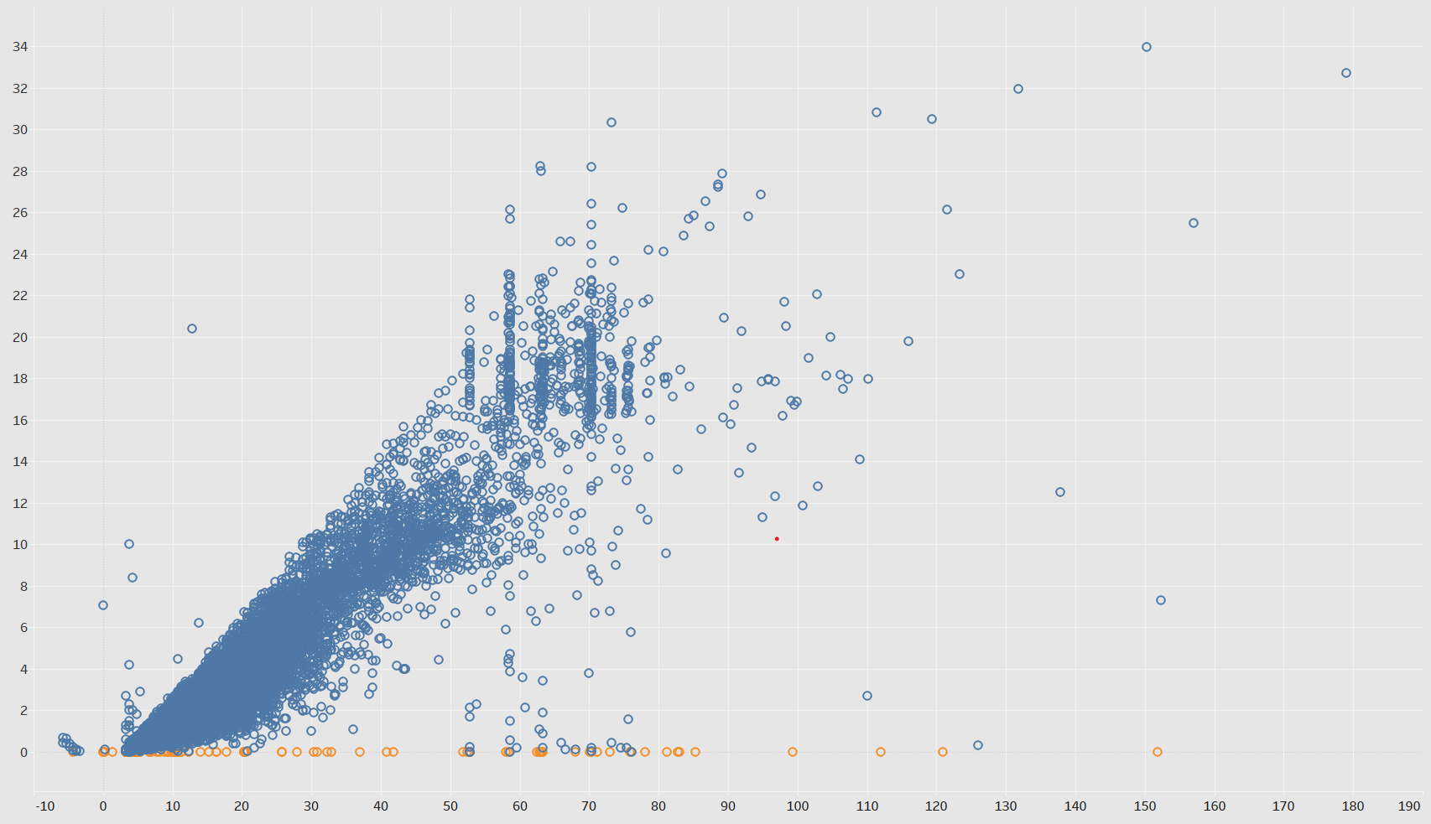
Exploratory Data Analysis of New York City TLC Data
Executive summary report
Prepared by: Automatidata Commissioned by: NYC Taxi & Limousine Commission
Project Overview
The NYC Taxi & Limousine Commission engaged Automatidata to develop a regression model to predict taxi fares. As part of this initiative, Automatidata's data team conducted an initial analysis of the data provided by the Commission. The goal was to outline key variable characteristics and evaluate the dataset’s suitability for generating accurate and meaningful insights.
Following our exploratory data analysis, the Automatidata data team identified trip distance and total fare as key variables to represent a taxi ride. The attached scatter plot, created in Tableau, illustrates the relationship between these variables to enhance the visualization
The Problem: After conducting exploratory data analysis (EDA) on the New York City TLC dataset, it became evident that certain records present challenges to accurate fare prediction, particularly those with negative fare values or unusually high outliers that deviate significantly from expected ranges. Such anomalies likely stem from data entry errors or rare scenarios that may distort the prediction model's performance
TLC Total Distance and Total Amount
Trip Distance
Proposed Solution: Remove records with negative fares and cap extreme outliers using the IQR method to ensure the dataset reflects typical ride patterns.
Total Amount
Conduct further EDA to refine insights and validate the significance of key variables like trip distance and fare amount.
Develop and test regression models, incorporating engineered features such as trip duration. Prepare visualizations and a detailed report to communicate findings effectively to stakeholders.
Keys to success
Thorough data cleaning to ensure quality and identify key variables like trip distance and duration that significantly impact fare predictions.
Leveraging robust visualizations and machine learning models to enhance accuracy and stakeholder insights.

